Slide 1
Securing server with iptables

Slide 2
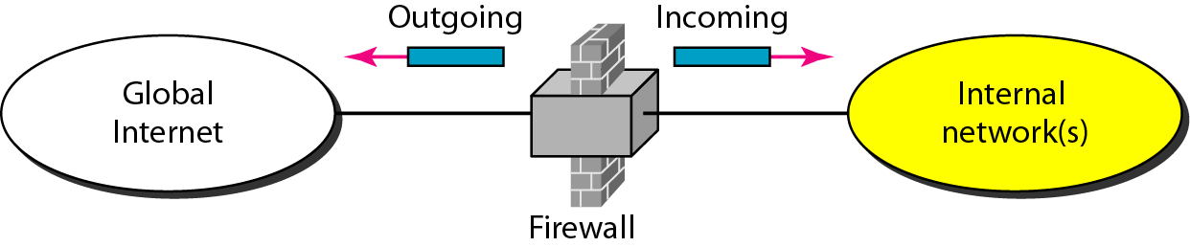
A firewall works through packet inspection. This means that the firewall screens incoming and outgoing packets to check whether the address, protocol, and port of the packet is either allowed or denied.
Netfilter is the default firewall offered through the Linux kernel.
Use the system-config-firewall tool for graphical interface
iptables command if you want to work from the command line.

Slide 3
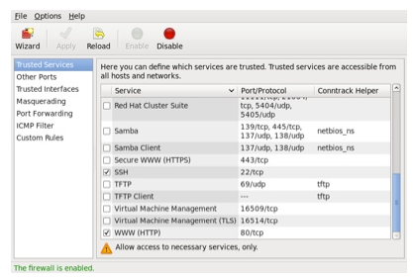
Setting Up a Firewall with system-config-firewall
The GUI screen to control the firewall is available from the menu (System > Administration > Firewall)

Slide 4
You can also configure basic trusted services, such as SSH, FTP and HTTP, by putting a tick in the appropriate checkbox and clicking the "Apply" button on the toolbar.
To make the configuration you just created operational,
1. Check that the iptables service is enabled.
2. Use the iptables -L command to verify that the rules have been applied.

Slide 5
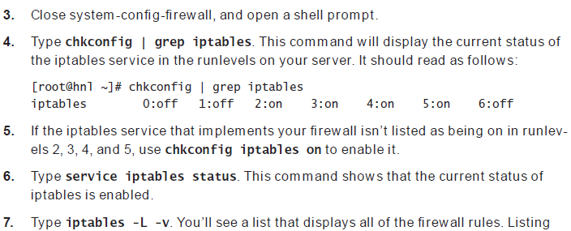

Slide 6
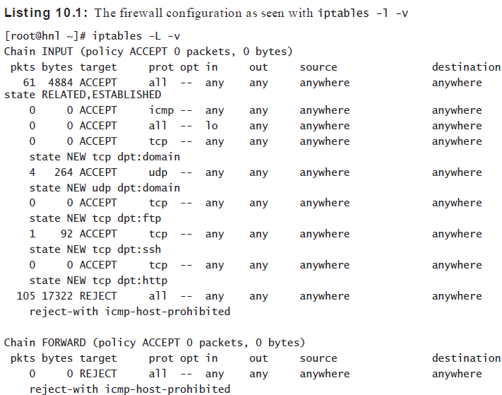

Slide 7
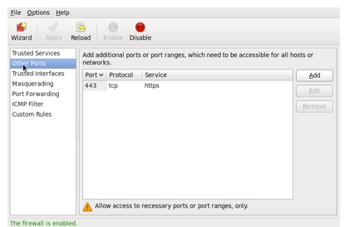
The "Other Ports" section allows you to open ports that are not covered in the "Trusted Services" section.

Slide 8
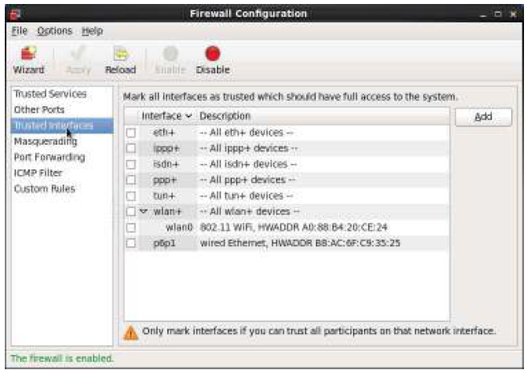
Trusted Interfaces
If your server works as a router and you want to specify some interfaces as trusted, from system-config-firewall
click Trusted Interfaces
select the interfaces you want to add

Slide 9
Masquerading
IP addresses from the private address ranges are used on the private network. These addresses cannot communicate on the Internet, but they will be translated to the public IP address on the interface that faces the Internet. This process is known as IP masquerading, also referred to as Network Address Translation (NAT ).
the NAT router maintains a NAT table. A port address is used to trace every connection in this NAT table.

Slide 10
Port forwarding- Port forwarding allows traffic arriving at the firewall via the internet on a specific port to be forwarded to a particular system on the internal network
ICMP Filtering
The Internet Control Message Protocol (ICMP) is used by client systems on networks to send error messages to each other.

Slide 11
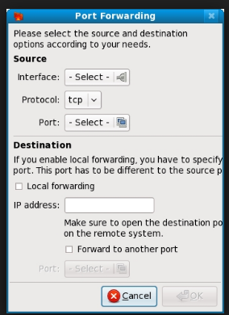

Slide 12
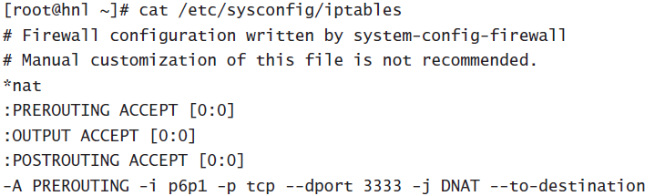
Configuration Files
Everything you do with system-config-firewall is saved to two configuration files
directory /etc/sysconfig
In the file iptables

Slide 13
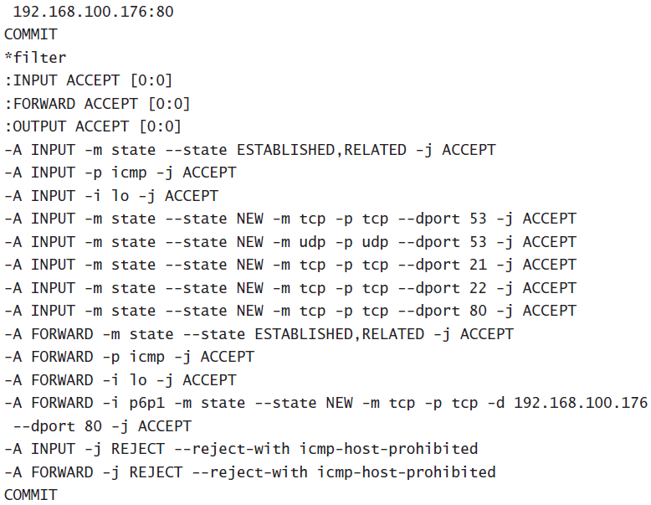

Slide 14
Setting Up a Firewall with iptables
The filter table is used.-NAT table
A table contains chains. A chain consists of a set of rules that is sequentially processed for each packet that enters the firewall until it finds a match.
INPUT -Incoming packets are processed in this chain.
OUTPUT- This chain is used for outgoing packets.
FORWARD -This chain is used on routers

Slide 15
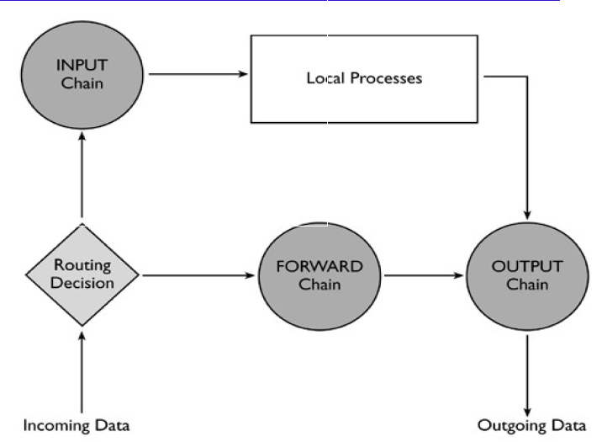
Packet Processing In iptables

Slide 16
Understanding How a Rule Is Composed
Elements in rules:
Modules -A module is an optional element
Interface – specific interface
IP Addresses - In a rule, you can allow or deny access to specific IP addresses
Protocol- Most rules allow or deny access to specific ports. These ports are always connected to the UDP or TCP protocol

Slide 17
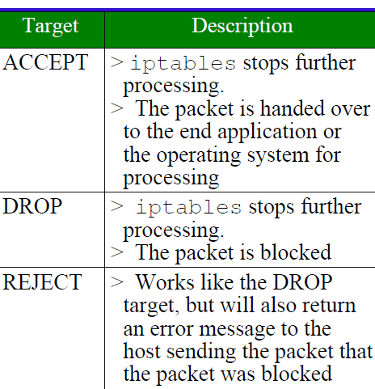
Target -The target is also a mandatory component in a rule. A target specifies what needs to be done with a matching packet.

Slide 18
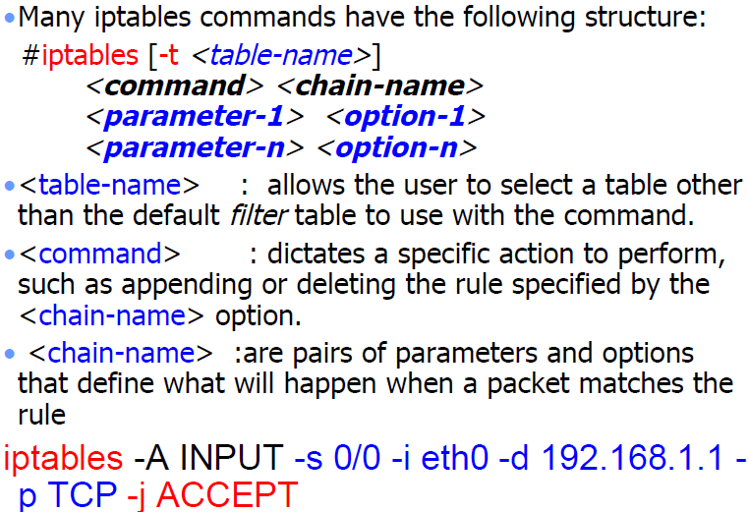
Structure

Slide 19
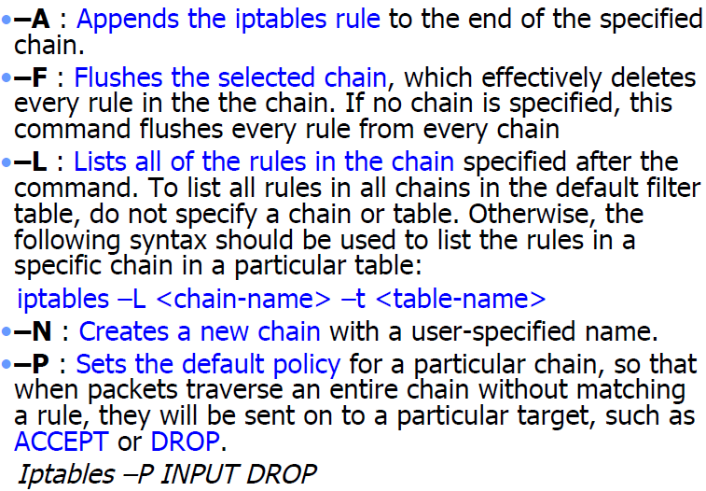

Slide 20
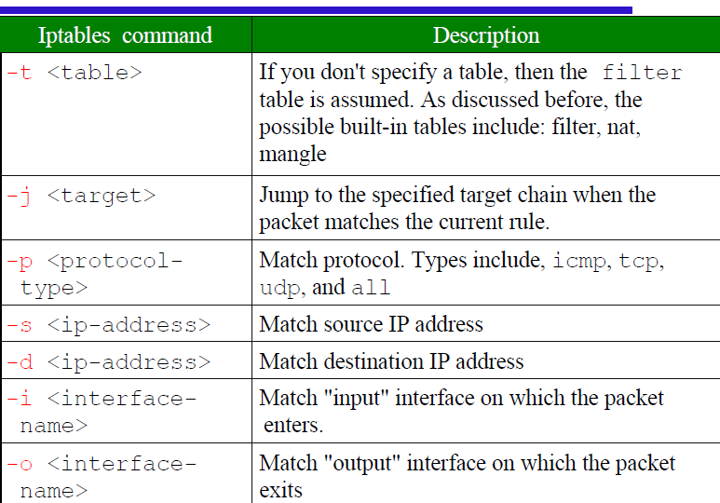
General iptable match criteria

Slide 21
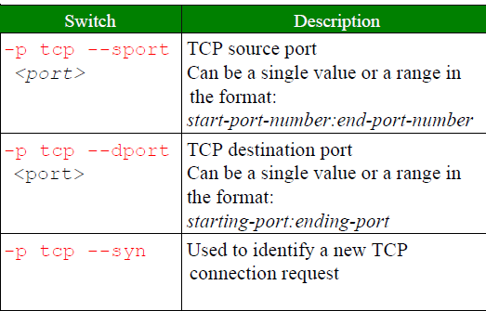
Common TCP Match Criteria

Slide 22
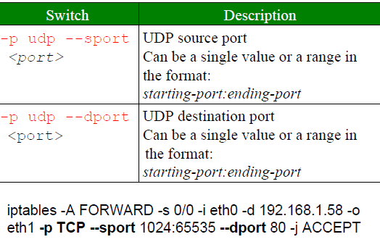
Common UDP Match Criteria

Slide 23
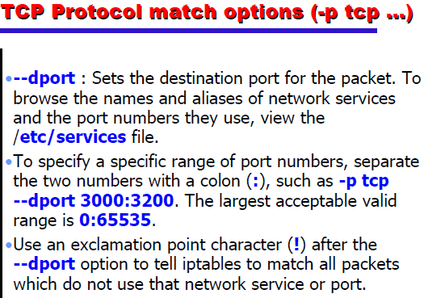

Slide 24
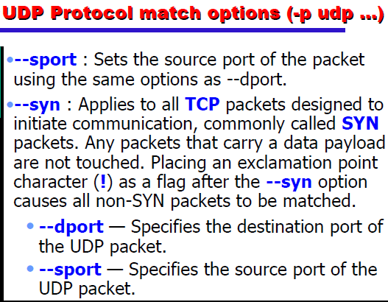

Slide 25
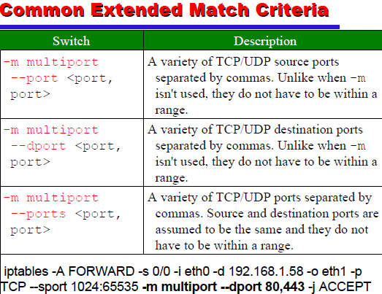
- -s

Slide 26
-m --state <state>
The most frequently tested states are:
ESTABLISHED: The packet is part of a connection that has seen packets in both directions
NEW: The packet is the start of a new connection
RELATED: The packet is starting a new secondary connection. This is a common feature of such protocols such as an FTP data transfer, or an ICMP error.

Slide 27
Configuring NAT
Network Address Translation (NAT) is a common technique that can be used on routers to have nodes on the private network go out with one registered IP address on the public network.

Slide 28
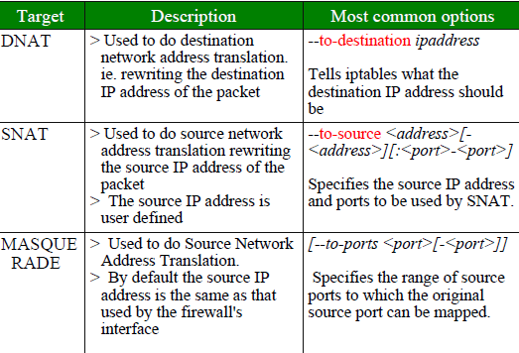

Slide 29
In the NAT table, three different chains are available.
PREROUTING-Alters network packets when they arrive.
POSTROUTING-Alters network packets before they are sent out.
OUTPUT-Alters locally-generated network packets before they are sent out.

Slide 30
https://forms.gle/hyx2mzS7ALVyzzfM6
https://forms.gle/ZGAM1Cg8iJojN8j76

